Slide 1
Chongqing University of Technology
ATAI
Advanced Technique of Artificial Intelligence
Chongqing Unive
t https://
github.com/thunlp/ERICA.
Sketch and Customize: A Counterfactual Story Generator
（ACL-2021)
Reported by Jia Wang
Notes:
反事实故事结尾的生成

Slide 2
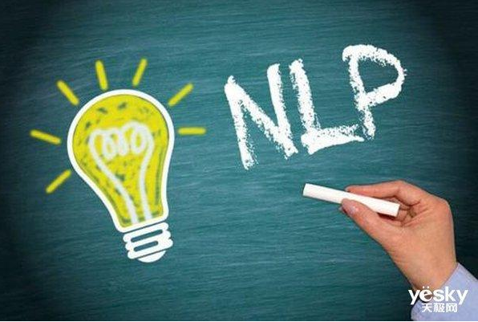
Chongqing University of Technology
ATAI
Advanced Technique of Artificial Intelligence
Chongqing University of Technology
1. Introduction
2. Approach
3. Experiments
4. Conclusion

Slide 3
Introduction
• Most of those conditional text generation tasks focus on how to generate good texts under certain conditions, while few work concentrates on how the consequence changes when the condition is modified.
• Sequence-to-sequence model's experimental results show that the model has difficulty in well capturing the causal relations between conditions and endings.
• Propose a sketch and customize framework for improving the causal reasoning ability of the text generation models
• Conduct experiments on a counterfactual story rewriting task to verify the performance of our proposed framework.
Notes:
大多数条件文本生成任务集中在如何在特定条件下生成好的文本，而很少有工作集中在修改条件时结果如何变化。
因此，seq-2-seq生成的反事实结局通常与反事实条件存在一定的冲突。

Slide 4
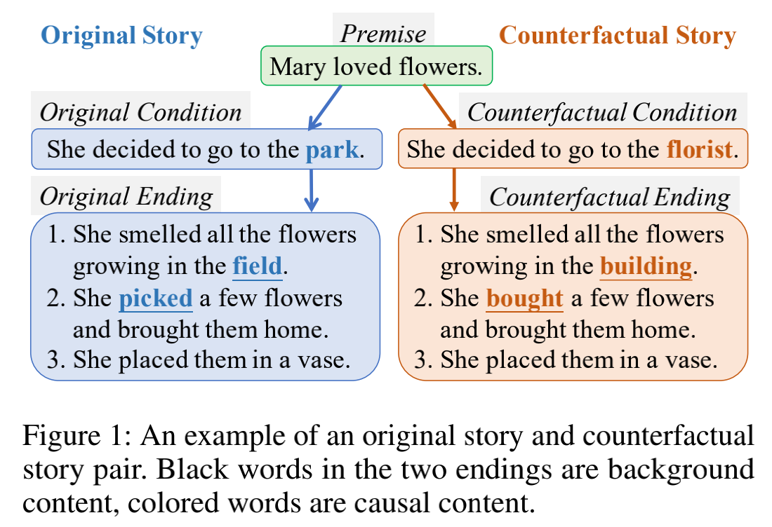
Approach
Notes:
考虑到条件和结局之间的因果关系，我们提出了一种两阶段的框架和定制方法，先勾勒故事背景，然后用反事实条件对其进行定制。

Slide 5
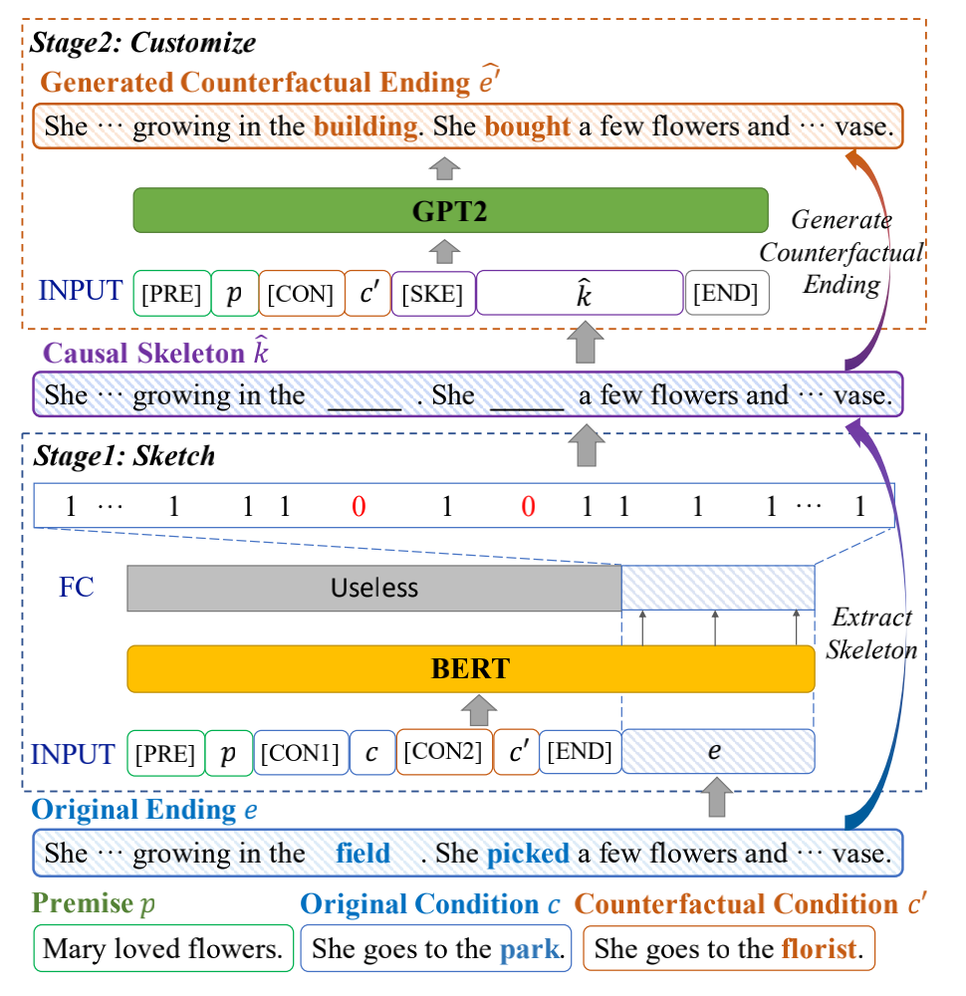
Approach
Notes:
在sketch阶段，我们引入了一个作为序列标记模型实现的casual 骨架提取器。casual骨架可以通过将casual内容替换为空白并仅保留背景内容来获得。特别地，在前提和两个条件的指导下，我们使用预训练的语言理解模型 BERT 通过检测原始ending中的每个单词是否应该用空格替换来预测骨架。在customize阶段，GPT2用于以前提、反事实条件和骨架为输入生成反事实结局。

Slide 6
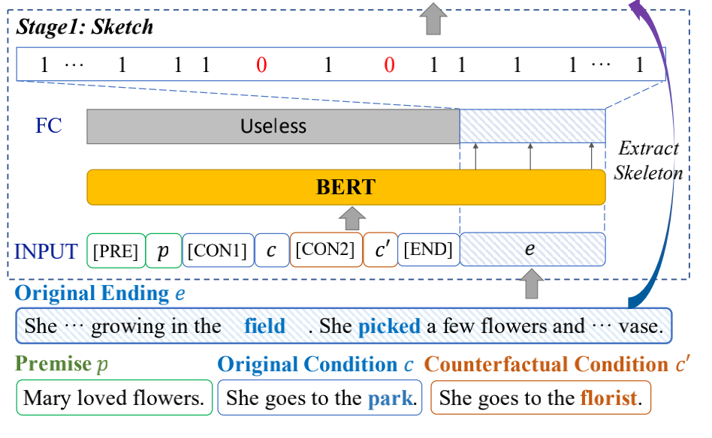
Approach
Stage 1: Sketch( the input formatting step, the representation step and the sequence labelling step.)
where denotes the representation of i-th word in the input sequence, is the length of S, and E is the dimension of the representation.
Notes:
由于原始结尾和反事实结尾是对称的，我们可以交换它们并使用反事实条件和结尾作为原始的，因此我们将训练样本加倍。
通过用空格替换结尾的因果词并将连续的空格进一步合并为一个空格，我们得到近似的ground-truth因果骨架

Slide 7
Approach
Stage 1: Sketch
To tackle this problem, we augment the current LCS skeleton with the following three alternative ways
1) randomly replacing 20% of background words with blanks,
2) randomly replacing 20% of background words with words sampled from the vocabulary,
3) randomly shuffling the order of background words in each skeleton.
Notes:
由于原始结尾和反事实结尾是对称的，我们可以交换它们并使用反事实条件和结尾作为原始的，因此我们将训练样本加倍。
通过用空格替换结尾的因果词并将连续的空格进一步合并为一个空格，我们得到近似的ground-truth因果骨架

Slide 8
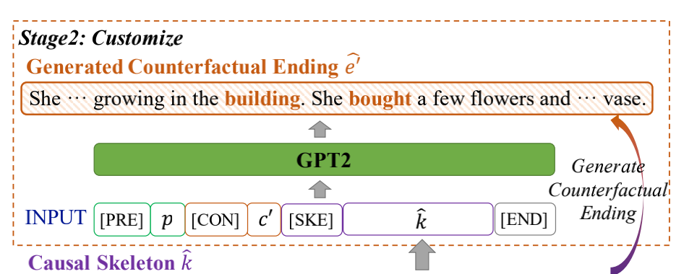
Approach
Stage 2: Customize
Notes:
在 Customize 阶段，给定骨架k，我们被要求完成填空任务以生成与反事实条件一致的故事结局。

Slide 9
Approach
Training
Notes:
在当前的故事重写任务中，casial词远少于背景词，主要是因为数据集注释中的变化要求最小。因此，我们采用加权交叉熵损失并为克服数据不平衡问题的因果词.
给定一个反事实条件，有多种方法可以修改现有的原始结局以适应反事实条件。例如，在验证和测试集中，为每个反事实条件提供了三个不同的结尾。因此，LCS 骨架可能仅反映一种可能的重写意图。结果，生成模型在学习各种反事实结局方面将受到限制，并损害泛化能力。为了解决这个问题，我们用以下三种替代方法来扩充当前的 LCS 骨架，1) 随机地用空白替换 20% 的背景词，2) 用从词汇表中采样的词随机替换 20% 的背景词，3)随机打乱每个骨架中背景词的顺序。之后，我们将连续的空白合并为一个空白并得到增强的因果骨架。在定制阶段的训练过程中，我们将 LCS 骨架和三种增强骨架结合在一起来训练生成模型。通过这种方式，模型可以更兼容嘈杂的骨架。

Slide 10
Approach
Inference
In the sketch stage
In the customize stage
Notes:
casual词被分配为具有最大概率的标签。因此我们得到因果词并用空格替换它们。然后我们将连续的空白合并为一个空白，得到预测的骨架 K
当预测到一个句子终止符时，解码过程完成并产生一个生成的反事实结尾 { ˆe01, ˆe02, . . . , eˆ0n} 长度为 n。

Slide 11
Experiments

Slide 12
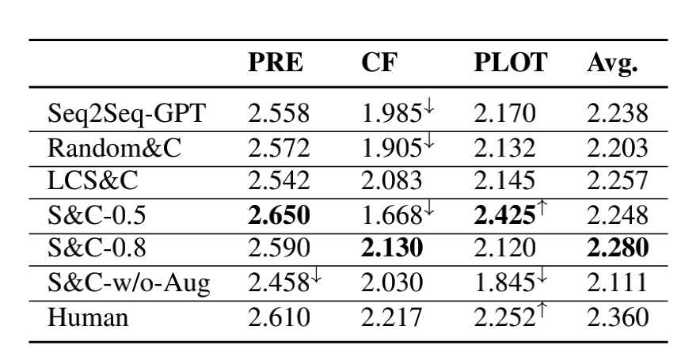
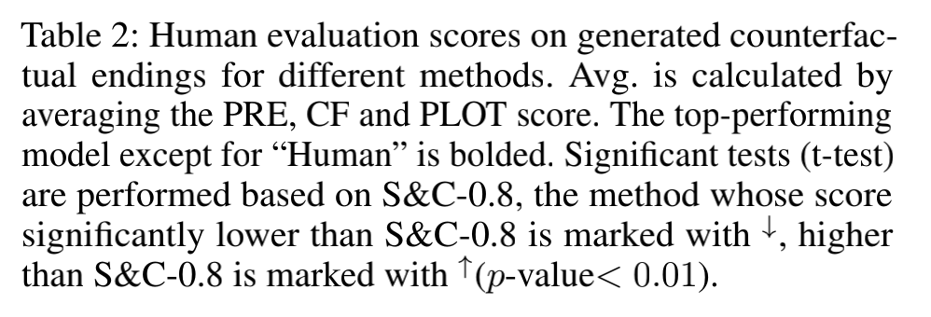
Experiments
Notes:
不同方法生成的反事实结局的人类评估分数
它表明我们的模型可以为反事实条件生成更一致的反事实结局，并避免简单地将原始结局复制为生成的结局。

Slide 13
Experiments
Notes:
Relevance to the original endings(ROUGE-L)

Slide 14
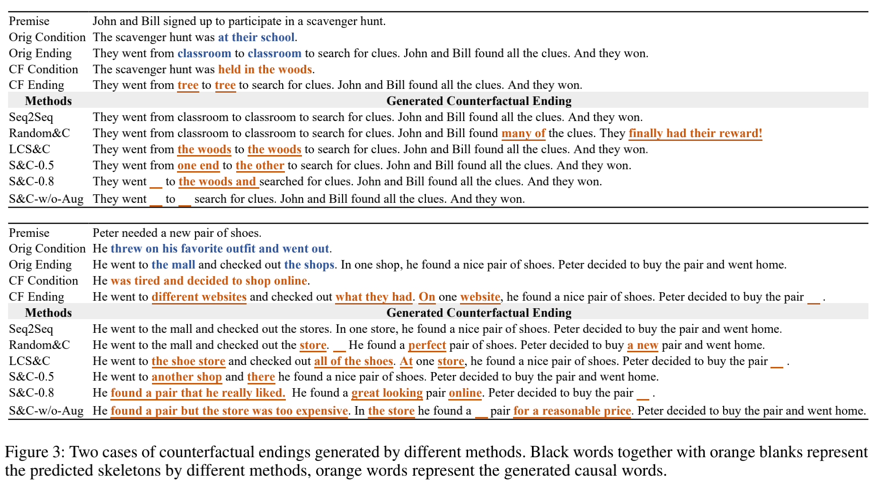
Experiments

Slide 15
Conclusion
In this paper, we propose a novel two-stage sketch-and-customize model for counterfactual story rewriting task. Different from the traditional sequence-to-sequence model, S&C explores the causal structure between the premise, condition and ending, and separate the story ending to two parts, the background content and the causal content. In the sketch stage, a skeleton is extracted to only contain the background content, by removing the causal content from the original ending. Then in the customize stage, a generation model is used to fill proper causal words in the skeleton under the guidance of the counterfactual condition. Experimental results show that our model significantly improves the consistency between the generated counterfactual ending and the counterfactual condition while keeping their relevance to the premise and the original ending.

Slide 16
Thanks

